Slide 1


Material Design
Semana IV

Slide 2
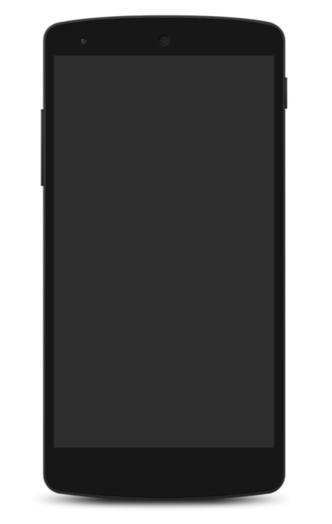


RecyclerView vs ListView
Optimizar el
funcionamiento
Uniformidad
VS
Personalización
Personalización
Manejo de recursos
Manejo de eventos

Slide 3
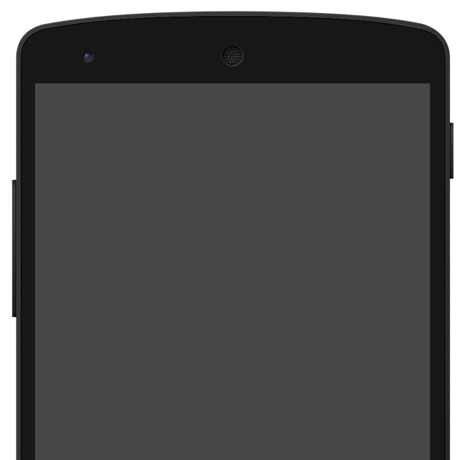
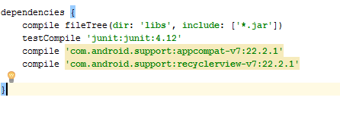
RecyclerView
Implementar libreria
compile 'com.android.support:recyclerview-v7:+'

Slide 4
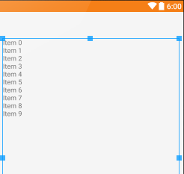
RecyclerView
Agregar en Layout
<android.support.v7.widget.RecyclerView
android:id="@+id/recycler_view"
android:layout_width="match_parent"
android:layout_height="match_parent" />

Slide 5
RecyclerView
Interface de los elementos layout/item.xml
<RelativeLayout xmlns:android="http://schemas.android.com/apk/res/android"
android:layout_width="match_parent"
android:layout_height="match_parent">
<TextView
android:id="@+id/title"
android:layout_width="match_parent"
android:layout_height="20dp" />
</RelativeLayout>

Slide 6
Agregar Adaptador de datos
RecyclerView
public class ReciclerAdapter extends RecyclerView.Adapter<ReciclerAdapter.MyViewHolder> {
private List<String> items;
private Context context;
public ReciclerAdapter(Context context, List<String> items) {
this.context = context;
this.items= items;
}
@Override
public int getItemCount() { return items.size(); }
@Override
public void onBindViewHolder(MyViewHolder itemsViewHolder, int i) {
itemsViewHolder.vTitle.setText(item.get(item));
}
@Override
public MyViewHolder onCreateViewHolder(ViewGroup viewGroup, int i) {
View itemView = LayoutInflater.
from(viewGroup.getContext()).
inflate(R.layout.fragment_item, viewGroup, false);
return new MyViewHolder(itemView);
}
public static class MyViewHolder extends RecyclerView.ViewHolder {
protected TextView vTitle;
public MyViewHolder(View v) {
super(v);
vTitle = (TextView) v.findViewById(R.id.title);
}
}

Slide 7
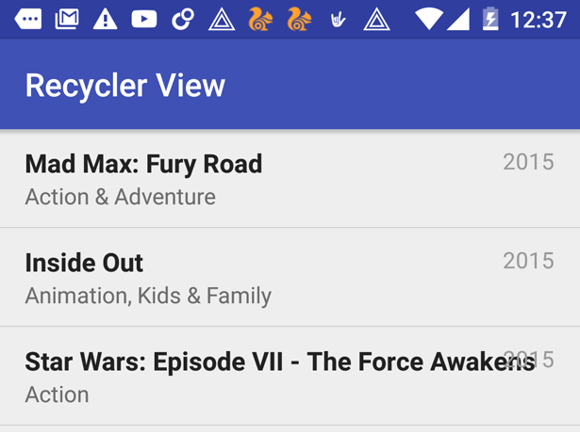
RecyclerView
Instanciar clases
RecyclerView recyclerView = (RecyclerView) view.findViewById(R.id.recycler_view);
recyclerView.setHasFixedSize(true);
LinearLayoutManager llmanager = new LinearLayoutManager(this);
llmanager.setOrientation(LinearLayoutManager.VERTICAL);
recyclerView.setLayoutManager(llmanager);
RecyclerAdapter myAdapter = new RecyclerAdapter(this, createList(30));
recyclerView.setAdapter(myAdapter);

Slide 8
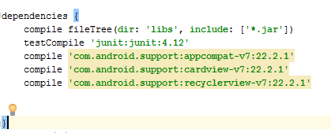
CardView
Implementar libreria
compile 'com.android.support:cardview-v7:21.0.+'

Slide 9
CardView
Agregar en Layout
<android.support.v7.widget.CardView
xmlns:card_view="http://schemas.android.com/apk/res-auto"
android:layout_width="match_parent"
android:layout_height="wrap_content">
</android.support.v7.widget.CardView>

Slide 10
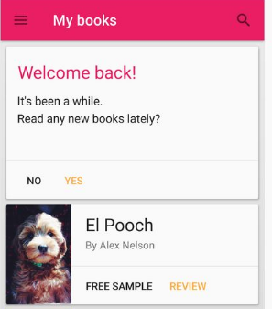
CardView
Definir estructura de items en CardView
……

Slide 11
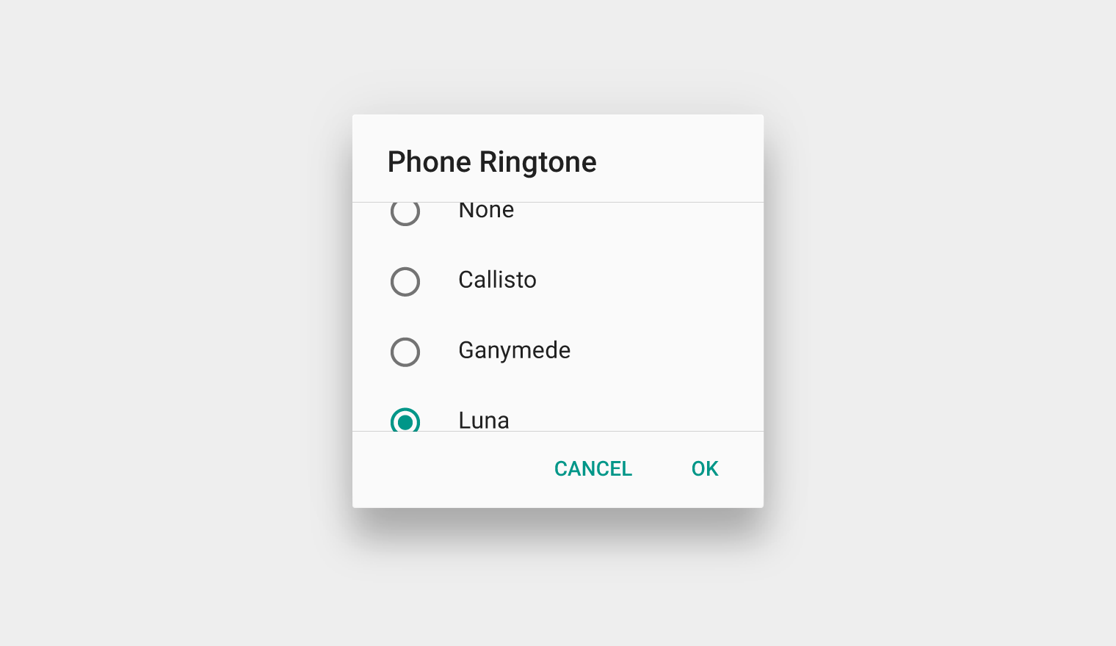
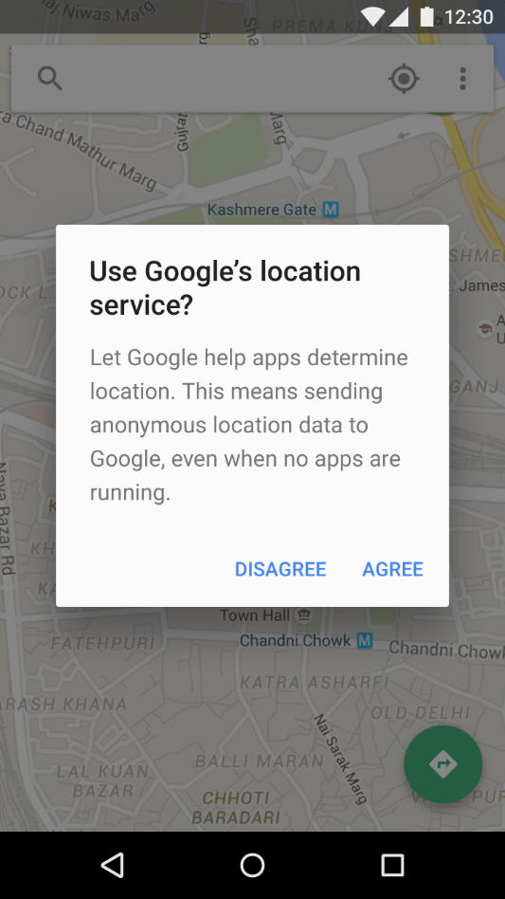
Dialog
https://material.google.com/components/dialogs.html

Slide 12
Dialog
Implementar libreria
compile 'com.afollestad:material-dialogs:0.7.8.1'

Slide 13
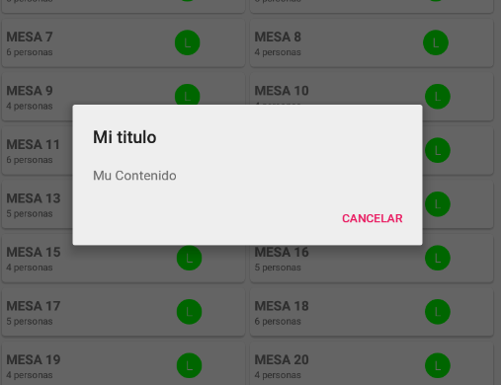
Dialog
Ejecutar Dialog
new AlertDialogWrapper.Builder(this)
.setTitle(R.string.title)
.setMessage(R.string.message)
.setNegativeButton(R.string.OK, new DialogInterface.OnClickListener() {
@Override
public void onClick(DialogInterface dialog, int which) {
dialog.dismiss();
}
}).show();

Slide 14
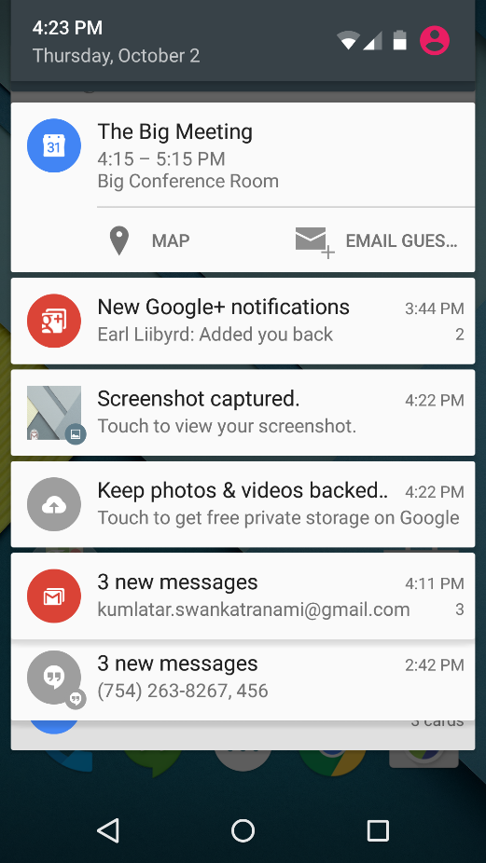
Notificaciones
https://material.google.com/components/dialogs.html

Slide 15
Notificaciones
Manejador de Notificaciones de Android
NotificationManager notificationManager = (NotificationManager)
getSystemService(NOTIFICATION_SERVICE);

Slide 16
Notificaciones
Manejador de Notificaciones de Android
Notification notification = new Notification.Builder(context)
.setVisibility(Notification.VISIBILITY_PUBLIC)
.setSmallIcon(R.drawable.ic_stat_player)
.addAction(R.drawable.ic_prev, "Previous", prevPendingIntent) // #0
.addAction(R.drawable.ic_pause, "Pause", pausePendingIntent) // #1
.addAction(R.drawable.ic_next, "Next", nextPendingIntent) // #2
// Apply the media style template
.setStyle(new Notification.MediaStyle()
.setShowActionsInCompactView(1 /* #1: pause button */)
.setMediaSession(mMediaSession.getSessionToken())
.setContentTitle("Wonderful music")
.setContentText("My Awesome Band")
.setLargeIcon(albumArtBitmap)
.build();

